Slide 1

DATA MOVEMENT AND TRANSFORMATION

Slide 2

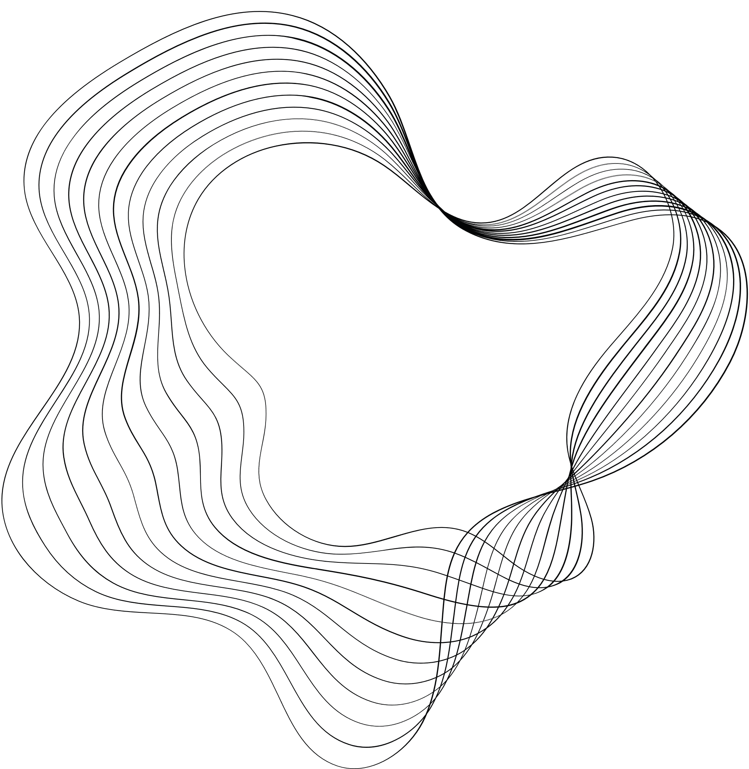
CONTENT
01
PROJECT STATEMENT
02
PROJECT OVERVIEW
03
PROCESS FLOW/ARCHITECTURE DIAGRAM
04
AZURE RESOURCE USED
05
PROJECT REQUIRMENTS
06
IMPLEMENTATION
07
CONCLUSION

Slide 3

PROJECT STATEMENT
The project includes real-time data processing through Azure services. Azure Data Factory facilitates seamless streaming data ingestion, while Azure Databricks processes and analyzes the data in near-real-time using Spark streaming. This synergistic approach enables organizations to derive timely insights and actionable intelligence from streaming data sources.

Slide 4

PROJECT OVERVIEW
In this project, we aim to implement a robust real-time data processing solution leveraging the capabilities of Azure Data Factory (ADF) and Azure Databricks. The primary objective is to ingest streaming data seamlessly through ADF and conduct near-real-time processing and analysis using Spark streaming in Azure Databricks.

Slide 5
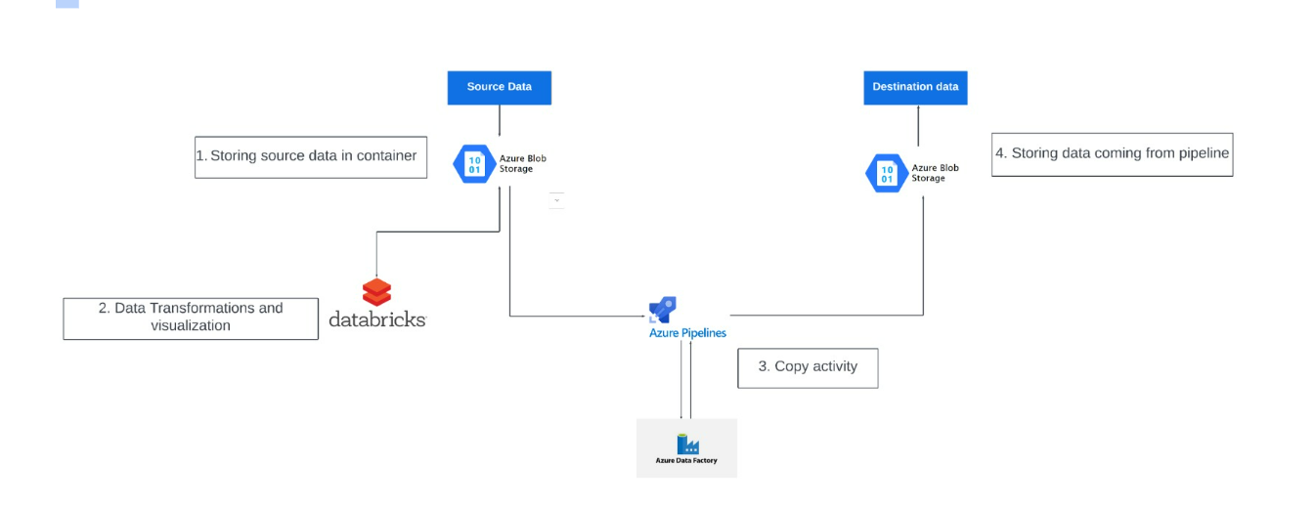
PROCESS FLOW /ARCHITECTURE DIAGRAM

Slide 6
AZURE RESOURCE USED
Azure Data Factory: Cloud-based data integration service for creating, scheduling, and managing data pipelines.
Azure Blob Storage: Scalable object storage service for storing and managing unstructured data in the cloud.
Azure Databricks: Apache Spark-based analytics platform optimized for Microsoft Azure.
Spark Streaming: Extension of Spark API enabling scalable, fault-tolerant stream processing of live data streams.

Slide 7
PROJECT REQUIRMENTS
Azure Subscription: Ensure access to an Azure subscription with the necessary permissions to create and manage resources.
Data Sources: Identify and configure the streaming data sources that will be ingested using Azure Data Factory.
Databricks Workspace: Set up a Databricks workspace and configure Spark clusters for real-time data processing.
Storage Configuration: Configure the Azure Storage Account to store the ingested and processed data.

Slide 8
IMPLEMENTATION
AZURE DATABRICKS :
1.Create a Azure Databricks account and Open the workspace
2. Create a Cluster and notebook
3. Create a Delta table and insert views in the table
4 Perform transformation, cleaning and using spark streaming

Slide 9
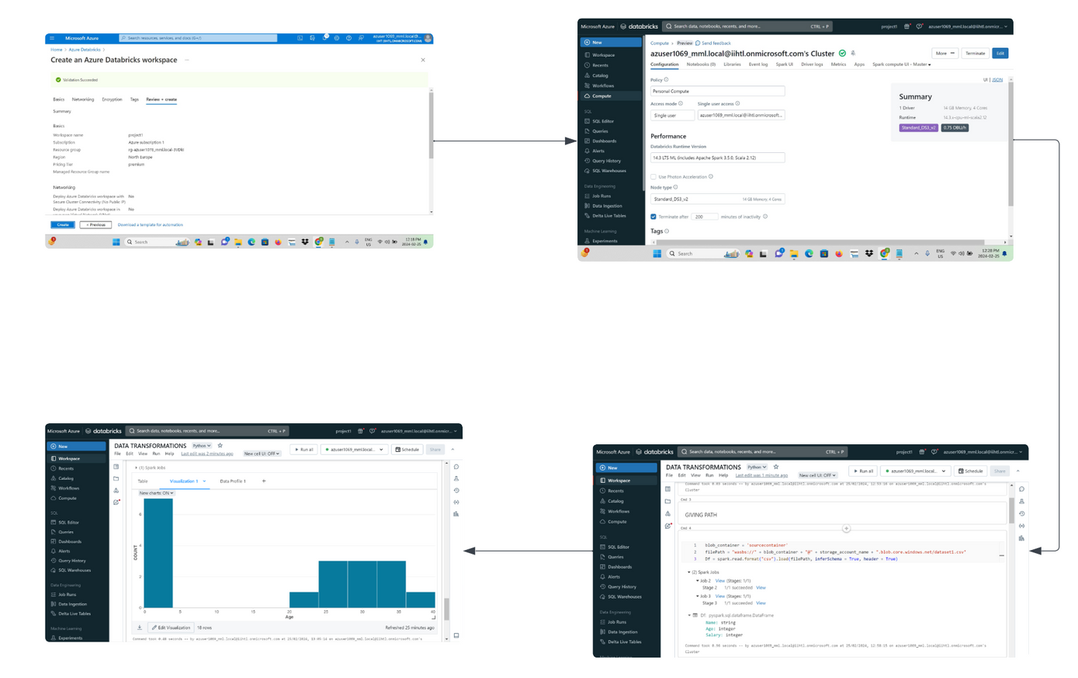
databricks workspace
creating cluster
visulazing data
performing transformations

Slide 10
AZURE DATAFACTORY:
Set up Azure Data Factory by creating a resource group, source storage account, and containers and Establish a destination storage account.
Utilize Data Factory to design pipelines for data ingestion.
Configure source and target settings, create a "Copy Data" task, and set up scheduling.
Monitor and validate successful data transfer for a streamlined and automated process.

Slide 11
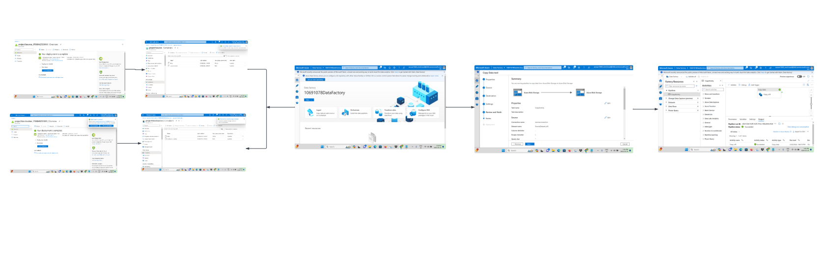
storage accounts and containers
setup datafactory
copy activity
validating and debuuging

Slide 12
CONCLUSION
This real-time data processing solution combines the strengths of Azure Data Factory and Azure Databricks, creating a dynamic and scalable architecture. It empowers organizations to derive actionable intelligence from streaming data sources in near-real-time, facilitating informed decision-making.

Slide 13
REFERENCES
https://learn.microsoft.com/en-us/azure/data-factory/quickstart-create-data-factory-powershell

